Slide 1


Security of the Border Gateway Protocol
Loukas Drosos
Supervisor: Dr. Vasileios Stathopoulos
Outline
BGP Overview
Possible Attacks Against BGP
Desired Properties for BGP Security
BGP Security Solutions

Slide 2
Security of the Border Gateway Protocol
Outline
BGP Overview
Possible Attacks Against BGP
Desired Properties for BGP Security
BGP Security Solutions
Loukas Drosos
Supervisor: Dr. Vasileios Stathopoulos

Slide 3
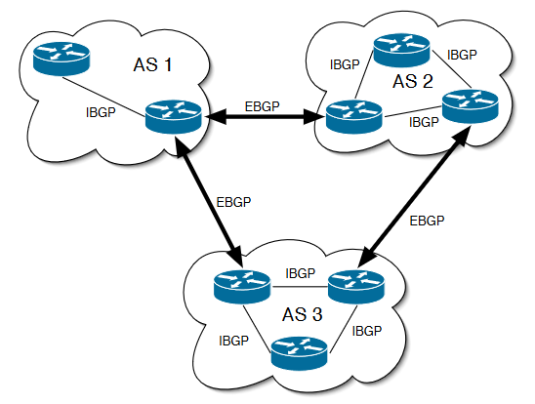
BGP Overview
Border Gateway Protocol:
Fundamental for Internet operation
eBGP, iBGP
Establishing BGP sessions (peering)
Exchanging routing information
Route Selection

Slide 4
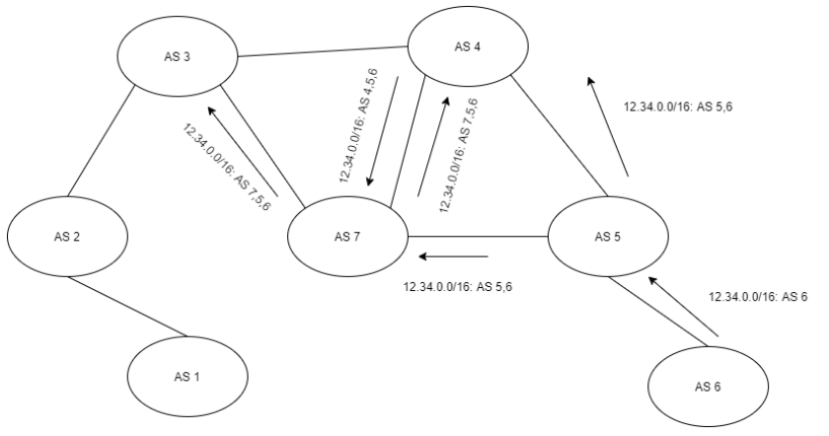

BGP Overview: BGP Route Selection
Shortest path (fewer hops)
Most specific matching prefix
Business Relationships: Customer-provider, Peer-peer
Customer routes > Peer routes > Provider routes
Multi-Exit Discriminator (MED)
Local Policies

Slide 5
BGP Overview: BGP Route Selection
Shortest path (fewer hops)
Most specific matching prefix
Business Relationships: Customer-provider, Peer-peer
Customer routes > Peer routes > Provider routes
Multi-Exit Discriminator (MED)
Local Policies

Slide 6
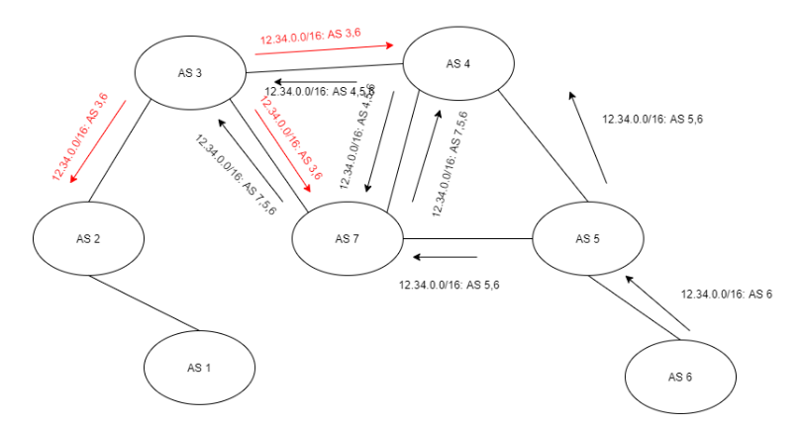
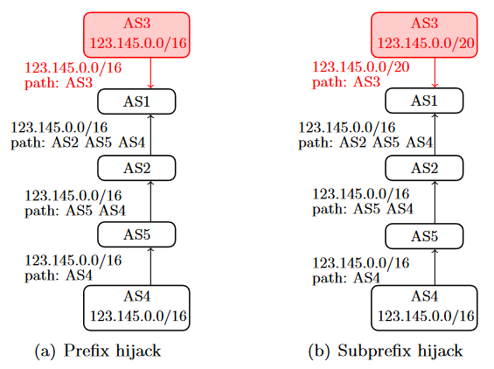
Attacks against BGP
(Sub)Prefix Hijack
Speaker Impersonation
Attacks against TCP
Path Altering
Protocol Manipulation Attacks
Denial of Service Attacks

Slide 7
Desired Properties for BGP Solutions
Performance Properties:
Convergence delay
Scalability
Computational Overhead
Bandwidth Overhead
Storage Overhead
Security and Privacy Properties:
Countermeasures against attacks
Data Confidentiality
Data Authentication and Integrity
Deployability Properties:
Adoptability
Backwards Compatibility
Seamless Data Forwarding

Slide 8
Desired Properties for BGP Solutions
Security and Privacy Properties:
Countermeasures against attacks
Data Confidentiality
Data Authentication and Integrity
Performance Properties:
Convergence delay
Scalbility
Computational Overhead
Bandwidth Overhead
Storage Overhead
Deployability Properties:
Adoptability
Backwards Compatibility
Seamless Data Forwarding

Slide 9
Desired Properties for BGP Solutions
Deployability Properties:
Adoptability
Backwards Compatibility
Seamless Data Forwarding
Security and Privacy Properties:
Countermeasures against attacks
Data Confidentiality
Data Authentication and Integrity
Performance Properties:
Convergence delay
Scalability
Computational Overhead
Bandwidth Overhead
Storage Overhead

Slide 10
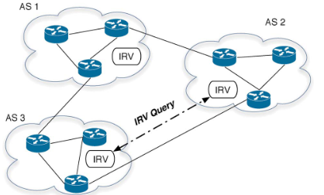
Desired Properties for BGP Solutions
Performance Properties:
Convergence delay
Scalability
Computational Overhead
Bandwidth Overhead
Storage Overhead
Deployability Properties:
Adoptability
Backwards Compatibility
Seamless Data Forwarding
Security and Privacy Properties:
Countermeasures against attacks
Data Confidentiality
Data Authentication and Integrity
BGP Security Solutions:
Overlay Network Method
Operation using IRV Servers:
Origin Validation
Privacy and Access Control Management
Routing Reports and Network Monitoring
Weaknesses:
Performance Overhead
Scalability and Adoption Limitations
Relies on Overlay Networks
Independent Operation from BGP
Interdomain Route Validation (IRV):
Independent Operation from BGP

Slide 11
Desired Properties for BGP Solutions
Deployability Properties:
Adoptability
Backwards Compatibility
Seamless Data Forwarding
Performance Properties:
Convergence delay
Scalability
Computational Overhead
Bandwidth Overhead
Storage Overhead
Security and Privacy Properties:
Countermeasures against attacks
Data Confidentiality
Data Authentication and Integrity
BGP Security Solutions:
Overlay Network Method
Operation using IRV Servers:
Origin Validation
Privacy and Access Control Management
Routing Reports and Network Monitoring
Weaknesses:
Performance Overhead
Scalability and Adoption Limitations
Relies on Overlay Networks
Independent Operation from BGP
Interdomain Route Validation (IRV):
Independent Operation from BGP

Slide 12
BGP Security Solutions:
Asymmetric Cryptography Methods
Secure BGP (S-BGP):
2 Public Key Infrastructures (PKIs): Authenticity of BGP messages.
Dynamic Route Attestations: AS path validation
Secure Origin BGP (soBGP):
3 PKIs: Less centralized than S-BGP
Static Route Attestations: AS Path validation
IPsec: Anti-replay for BGP messages
Pretty Secure BGP (psBGP):
BGPsec
PKIs: Less centralized than S-BGP
Prefix Assertion List (PAL): AS path verification
Resource Public Key Infrastructure (RPKI): Origin verification and Route authentication
Weaknesses:
Computational and Network Overhead
Security Proportional to Deployment
Vulnerable to some already known attacks
Single or multiple weak points due to PKIs

Slide 13
BGP Security Solutions:
Symmetric Cryptography Method
Secure Path Vector (SPV):
Independent from BGP
Improvement over Message Authentication Codes (MACs)
Computationally intensive cryptographic operations: Path Integrity
Weaknesses:
Intensive cryptographic operations: Computational overhead
Lots of data transmission: Network overhead
Vulnerable against AS path forgery

Slide 14
Conclusion
BGP Security = Internet reliability
BGP Vulnerabilities:
Susceptible to attacks
Traffic interception, data breaches, and network disruptions
Challenges with current solutions:
Computational and network overhead and security performance tradeoff
Fail to address all threats
Deployment complexity
Future Research and Collaboration:
Balance security and network performance with overhead
Effective solutions without requiring mass adoption beforehand
Collaboration among network operators, researchers, and policymakers
Thank you!

Slide 15
Thank you!

